Slide 1

Instagram Spam Detection Using Machine Learning
Submitted By
Dhruva
Master of Commerce
University of Allahabad
Guide
Mr. Vikas Goel
Notes:
NOTE:
To change the image on this slide, select the picture and delete it. Then click the Pictures icon in the placeholder to insert your own image.

Slide 2
What is Instagram Spam?
Why detect spam?
Instagram spam accounts are fake profiles created to:
Increase followers artificially
Promote advertisements
Send phishing or scam messages
Spread malicious links
Mislead genuine users
Protects users from fraud
Improves user experience
Prevents fake engagement
Helps social media platforms maintain trust

Slide 3
Problem Statement & Objective
Problem Statement
It is difficult to manually identify fake Instagram accounts because millions of new accounts are created every day.
Objective
Develop a machine learning model that predicts whether an Instagram account is:
Genuine
Fake (Spam)
using account profile features.

Slide 4
Dataset Features
Feature | Description
edge_followed_by | Number of followers
edge_follow | Number of following
username_length | Username length
username_has_number | Username contains numbers
full_name_has_number | Full name contains numbers
full_name_length | Length of full name
is_private | Private account or not
is_joined_recently | Recently created account
has_channel | Has broadcast channel
is_business_account | Business account
has_guides | Uses Instagram guides
has_external_url | External website link
is_fake | Target column
NOTES
Dataset contains fake and genuine Instagram accounts.
No missing values.
Duplicate records were removed.

Slide 5
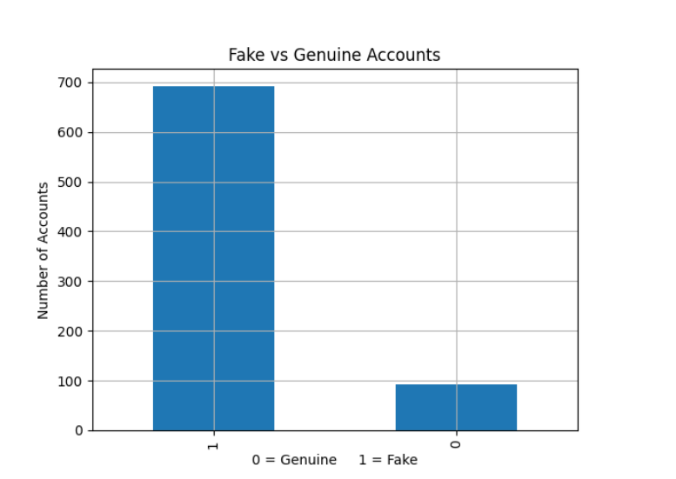
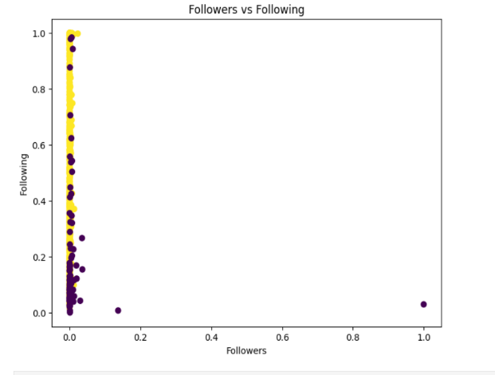
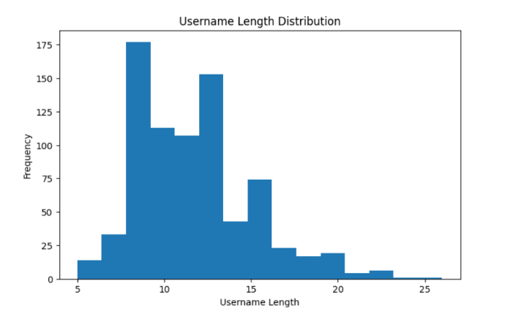
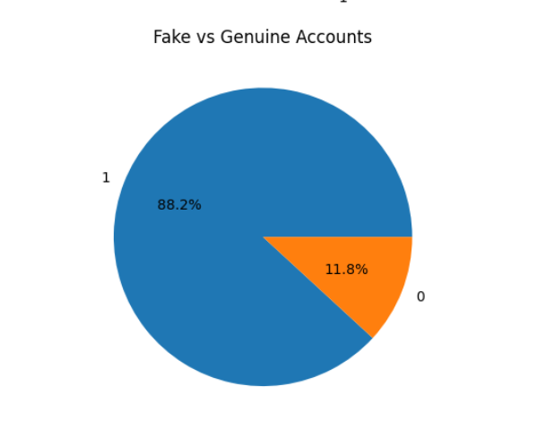
Exploratory Data Analysis (EDA)
BAR GRAPH
SCATTER PLOT
Fake accounts are more than genuine accounts.
Followers and following show different patterns.
Username lengths vary among accounts.
HISTOGRAM
PIE CHART

Slide 6
Machine Learning Process
Dataset
The dataset is a collection of data containing the features (inputs) and the target variable used to train and test the model.
Data Cleaning
Data cleaning removes or corrects missing, duplicate, and incorrect values to improve data quality.
Exploratory Data Analysis
EDA helps understand the data by analysing its structure, patterns, relationships, and distributions using statistics and visualizations.
Input & Target Separation
The dataset is divided into input features (X) used for prediction and the target variable (y) that the model learns to predict.
Train-Test Split
The data is split into training and testing sets so the model can be trained on one portion and evaluated on unseen data.
KNN Model
The K-Nearest Neighbours (KNN) algorithm predicts the class of a new data point based on the majority class of its nearest neighbours.
Prediction
Accuracy Evaluation
The model's accuracy is calculated by comparing the predicted values with the actual target values to measure its performance.
The trained KNN model is used to predict the target values for the test data or new unseen data.

Slide 7
K-Nearest Neighbours (KNN) Algorithm
How KNN Works
KNN predicts the class of a new account by looking at the majority class among its nearest neighbours.
Supervised Machine Learning algorithm.
Finds the nearest data points.
Uses majority voting Predicts.
Fake or Genuine account
Followers | Following | Username Length | Prediction
200 | 180 | 12 | ?
KNN predicts the class of a new account by looking at the majority class among its nearest neighbours.
Nearest Account | Class
Account A | Fake
Account B | Fake
Account C | Genuine
Since 2 out of 3 nearest neighbours are Fake, the new account is classified as: Fake Account

Slide 8
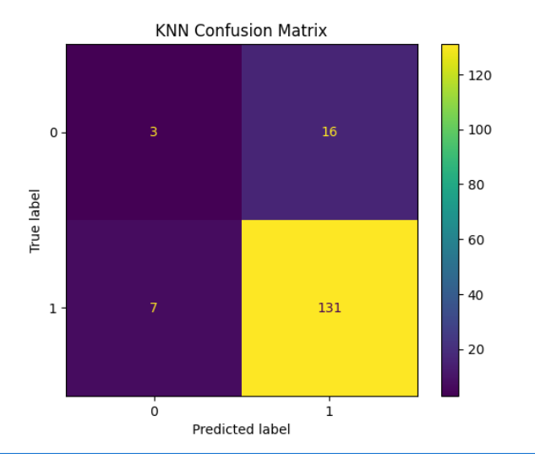
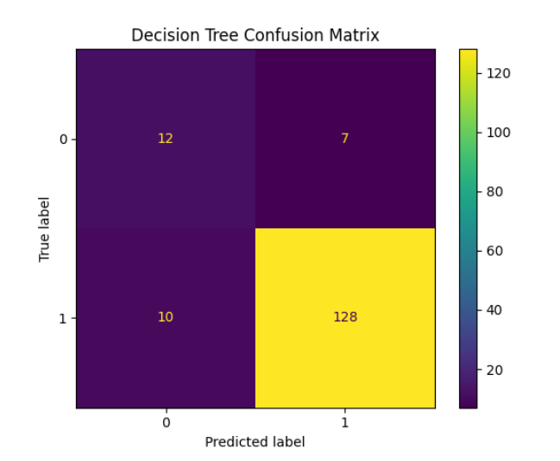
Results
========== KNN ==========
Accuracy = 0.8535031847133758
Confusion Matrix
[[ 3 16]
[ 7 131]]
Classification Report
precision recall f1-score support
0 0.30 0.16 0.21 19
1 0.89 0.95 0.92 138
accuracy 0.85 157
macro avg. 0.60 0.55 0.56 157
weighted avg. 0.82 0.85 0.83 157
========== Decision Tree ==========
Accuracy = 0.89171974522293
Confusion Matrix
[[ 12 7]
[ 10 128]]
Classification Report
precision recall f1-score support
0 0.55 0.63 0.59 19
1 0.95 0.93 0.94 138
accuracy 0.89 157
macro avg. 0.75 0.78 0.76 157
weighted avg. 0.90 0.89 0.90 157

Slide 9
Advantages & Limitations
Advantages
Simple to implement
Easy to understand
Good accuracy
Useful for spam detection
Limitations
Dataset is imbalanced
Accuracy depends on value of K
Larger datasets increase prediction time

Slide 10
Conclusion & Future Scope
Conclusion
Successfully detected fake Instagram accounts using KNN.
Data visualization helped understand the dataset.
KNN achieved satisfactory accuracy.
Future Scope
Collect larger datasets
Balance the dataset
Compare with other ML algorithms
Build a real-time spam detection system

Slide 11
Thank you

